Slide 1
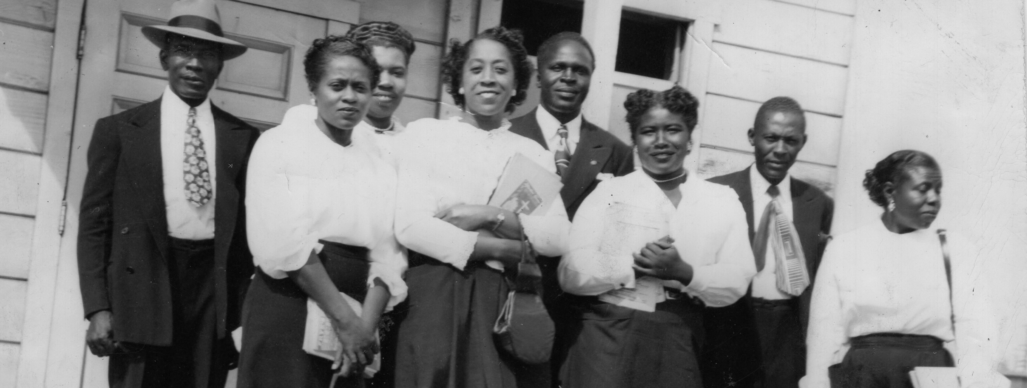
A PROUD HERITAGE
LONG BEACH AFRICAN AMERICAN COMMUNITY

Slide 2
Areas of Interest
Family & Community
Faith
Sports Legacy
Arts & Music
Economic Development
Housing

Slide 3
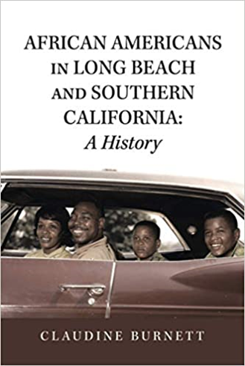
Most towns throughout America have a history of racism and Long Beach is no exception. Early Long Beach has been characterized as a city of almost puritanical values-a church going citizenry that allowed no alcohol and practiced conservative ideals.
It was founded and settled by Bible belt, white, Midwesterners, conservative in their political and social views. It was famous for having the largest Bible study group in the nation and its draconian “purity” ordinances-making it illegal to wear a bathing suit that didn’t have skirts, sleeves or was too short or too tight.
Though the many churches in town preached tolerance and acceptance of blacks and other minorities, the truth was they did not want them living anywhere near them. “Property values going down,” was the most often cited reason for this exclusion, not outright racism. Deeds to property were later written to exclude blacks from purchasing homes in their community, though some did so in an outlying area close to the city call the “Negro District” (later Central Long Beach). From here they could find employment in the white community as cooks, maids, chauffeurs, and other positions whites did not want.
White settlers to Southern California neglected to see that the region was largely colonized by those with African blood. After Spain entered the slave trade in the 15th century, Africans, indigenous, and European blood comingled and many of those with mixed blood were recruited into the Spanish armed forces as conquistadores.
In Northern California, African Americans, many still slaves, helped garner the gold that brought more and more immigrants to the Golden State. Whereas Northern California was pro Union during the Civil War, the Southland was a hotbed of Southern sympathizers and not the most welcoming oof places for African Americans to settle. It would not be until the 1880s that a small number of African Americans began to migrate to Southern California. From 188 African Americans in Los Angels County, the number increased to 1,817 in 1890; to 2,841 in 1900-21 of them living in Long Beach. 1880 was also the year that the community later to be known as Long Beach came into being.
Authored by:
Claudine Burnett
“I hope the information presented here will increase your knowledge of
Long Beach and Southern California history and the struggles experienced
by African Americans.”

Slide 4
Family & Community

Slide 5
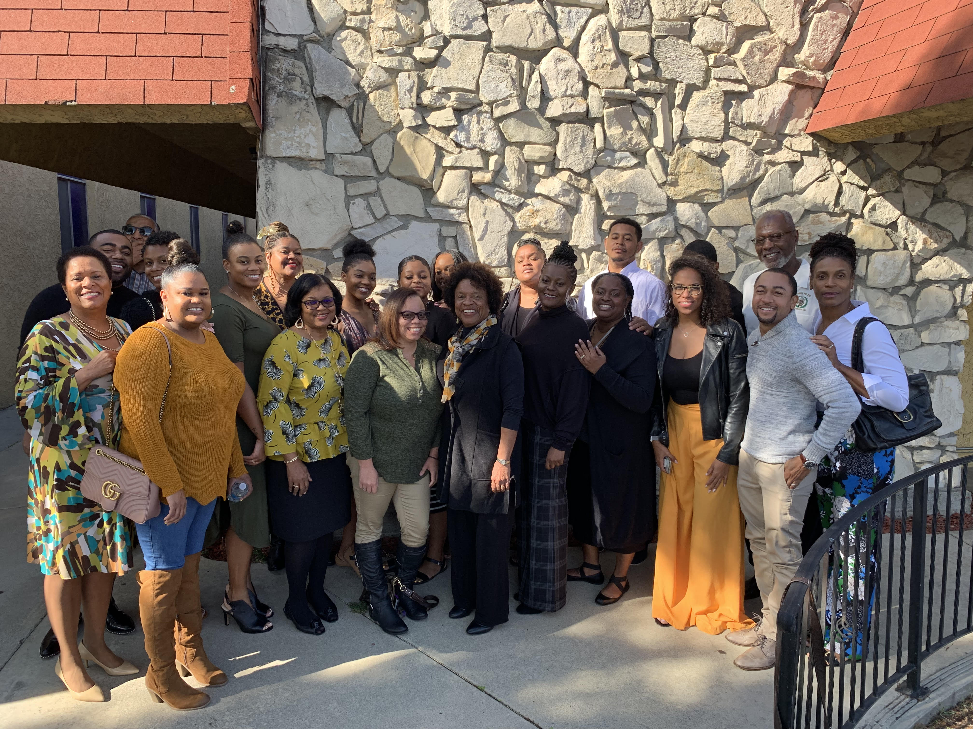
Photo Collage

Slide 6
FAITH
Est. | Central Area Black Churches | Address
1903 | 1st African American Mission Church formed, later became Christ 2nd Baptist Church
1907 | Christ Second Baptist | 1471 MLK Ave., 90813
1911 | Grant African Methodist Episcopal (AME) | 1129 Alamitos Ave, 90813
1943 | New Hope Baptist | 1160 E. New York St, 90813
1944 | St Mark Baptist | 1703 Lemon Avenue, 90813
1945 | White Rose Church of God in Christ (COGIC) | 1001 E. Anaheim St., 90813
1945 | St. Vessel Colored Methodist Episcopal (CME) | 1953 MLK Ave, 90813
1952 | St John Baptist | 741 E. 10th St, 90813
1956 | The Greater Harvest COGIC | 1144 Olive Ave, 90813
1950s | Golgotha Trinity | 1630 E. 14th St, 90813
1961 | Antioch | Original-1535 Gundry Ave, 90813 Current-350 Pine Ave, 90802
1962 | 1st Providence | 801 E. Hill St, 90806
1960s | New Liberty | 2091 Olive Ave, 90806
1960s | Myrtle Avenue Church of Christ | 1076 Myrtle Ave, 90813
2000s | Love Unlimited | 1760 MLK Ave, 90813
2000s | Grace Memorial Baptist Church | 1021 E. 19th St, 90806
The Role of the Black Church in Creating Change
Historically the black church has been a place for creating individual, systemic, and political change within the Black community. From its emergence in the late 18th century to its present-day relevance, the Black church has and will always serve as a safe haven for African Americans, a place to worship God together, and a place where we are motivated to rebuild our communities. You can guarantee that on Sunday between the hours of 8 a.m. (early morning service) to 3 p.m. (afternoon service) there will be a large population of Blacks attending church.
Pastors in the Black church wield much influence in our community. They fill us up with wisdom, knowledge, and of the Word of God. Our pastors pray with and for us, provide resources and tools, even visit us when we are sick. Our pastors continue to serve as our “elected” spiritual representatives.

Slide 7
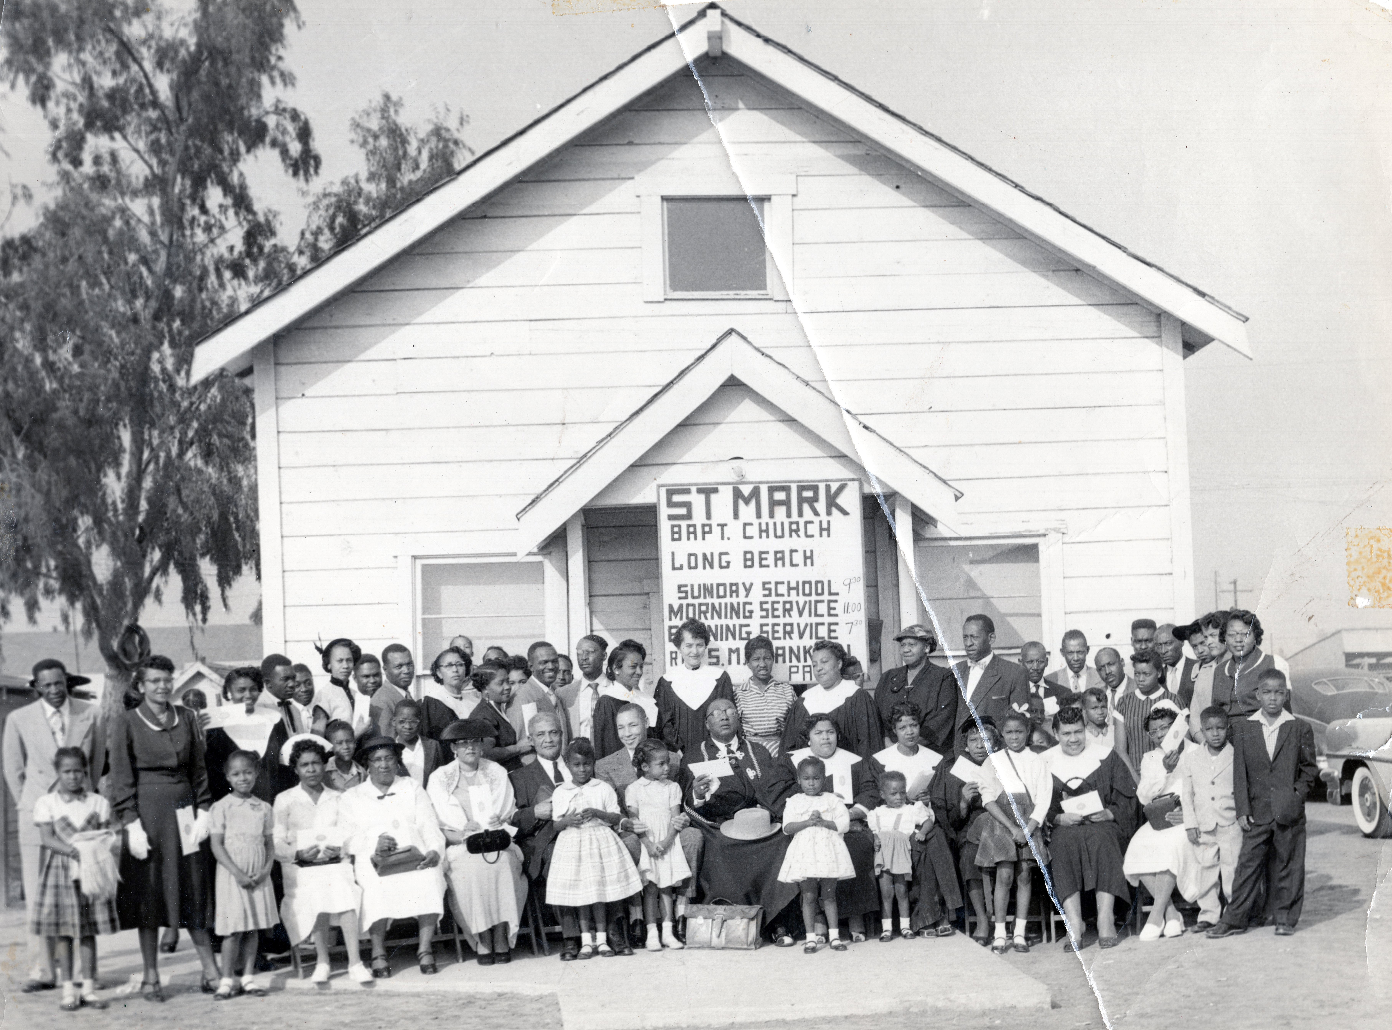
Photo Collage

Slide 8
Long Beach Black Church from 1903
Christ Second Baptist Church
Grant African Methodist Episcopal Church
Established 1907
Established 1911
New Hope Baptist Church
St Mark Baptist Church
Established 1943
Established 1944

Slide 9
Sports Legacy

Slide 10
Tour sites Pan African, LB Community Improvement, New Hope, SMBC, 2nd Baptist, VIP, Anaheim Shopping Center, Myrtle Ave, Olive, McBride Home, Japanese influence & Art Center
Arts & Culture

Slide 11
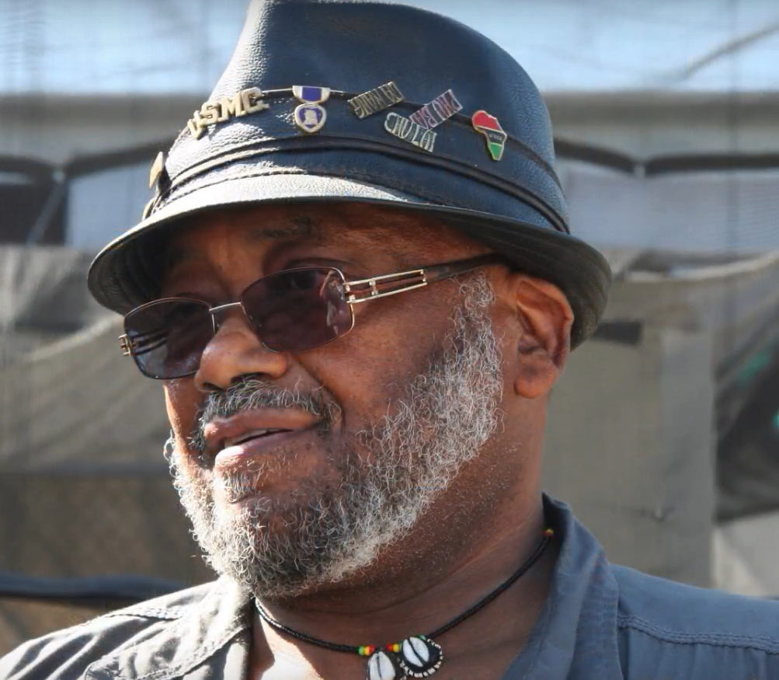
Akinsanya Kambon
Akinsanya Kambon – a.k.a. Mark Teemer (born in Sacramento, CA, 1946). Akinsanya Kambon is a multimedia artist. He has a master’s degree in fine art. He is a prolific artist, and over his life has worked in all medias. Currently he is working in oil, watercolor, charcoal, pen and ink, pottery, ceramic, and bronze sculpting. Kambon’s artworks are influenced by his life experiences. This includes being stricken with polio at age three, military service – United States Marine Corps, political activist, college professor, public speaker, and extensive travels in Africa. Akinsanya Kambon is a revolutionary artist. His philosophy is “art is not for arts’ sake, but must be used to uplift humanity”.
Drafted to United States military service at age 19 to serve in the Vietnam War, Akinsanya Kambon returned to the U.S. in the height of the 60’s counterculture, the African-American Civil Rights Movement, and the Black Power Movement. He was then drafted into the Black Panther Party (BPP), and served as the Lieutenant of Culture for the Sacramento Chapter. In that position he served by interpreting and communicating the principles of revolutionary culture, and Black Panther ideology. His primary means of fulfilling this function was through promoting artistic expression, and socio-political education.
Working tirelessly in his community efforts, his message today is still “education”. In 1984 inspired by his BPP indoctrination to serve the community, Kambon founded the nonprofit organization, Pan African Art (PAA) in Long Beach, CA. Now celebrating 30 years PAA continues to provide free art, culture, and leadership programs to community youth. Kambon has traveled extensively in Africa since 1974. There he has lectured, held art exhibits, provided art/culture workshops to youth, met with top civic and military leaders, and studied under local artists.
The artworks of Akinsanya Kambon are thought provoking and captivating. He has unique mastery in use of color, form, and subject. His very impressive oeuvres are a beautiful tapestry of his knowledge, and life experiences enriching the lives of his viewers. The Kambon exhibition is a unique experience. As the contemporary cultural and political world changes, his works become a visual and artistic witnesses to humanity. They will become ever more valuable when viewed through this artist’s effort to chronicle aspects of a living, changing culture that he feels should be retained and preserved. In his words, “There is nothing more significant for me than using art to educate people on the African experience, history, and culture. Unapologetically he says, “It is o.k. for us to have artworks that are priceless – our experience is priceless”.
Akinsanya Kambon lives in Long Beach, CA. As a professor he taught for 26 years at California State University, Long Beach. He has now retired from teaching. Driven by his passion to create art he works daily in his private studio. 2228 & 2240 Atlantic Ave

Slide 12
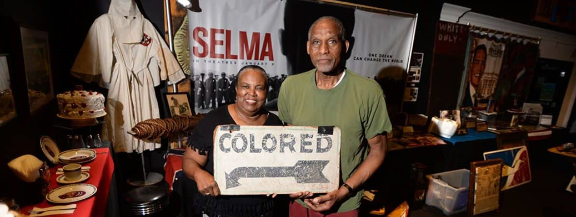
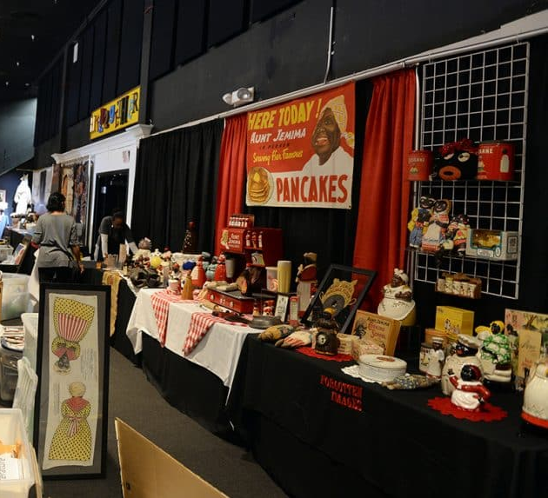
FORGOTTEN IMAGES
David and Sharon McLucas are owners of the Forgotten Images: A Traveling Educational Exhibit and Museum. “Their exhibit featured thousands of lost and forgotten artifacts that span two centuries of the African-American experience in America.” .
David McLucas stated that this was a personal collection that he started from home and people would casually stop by. He ended up doing tours in his own home.
Once he had 20,000 items in his collection, he realized there was need to have information on what went on with the African Americans and the slaves. He learned that lot of items he seeks were achievable to find, so he went out and started collecting.
Both David and Sharon would be all over the nation seeking these items. David said “It’s kind of what we do similar to the TV show American Pickers. It’s the same system where you go out on the road and try to get leads to different flea markets, antique stores and different homes.”
Their collection became a traveling and educational exhibit after some of his friends, who were educators, asked him to bring the items to their schools.
David believes his exhibit will greatly impact the Long Beach area. The aquarium hopes the display will highlight all the positive and negative phases of the African-American history. Together, they will instill a sense of knowledge, awareness and responsibility for everyone that comes into contact with it.

Slide 13
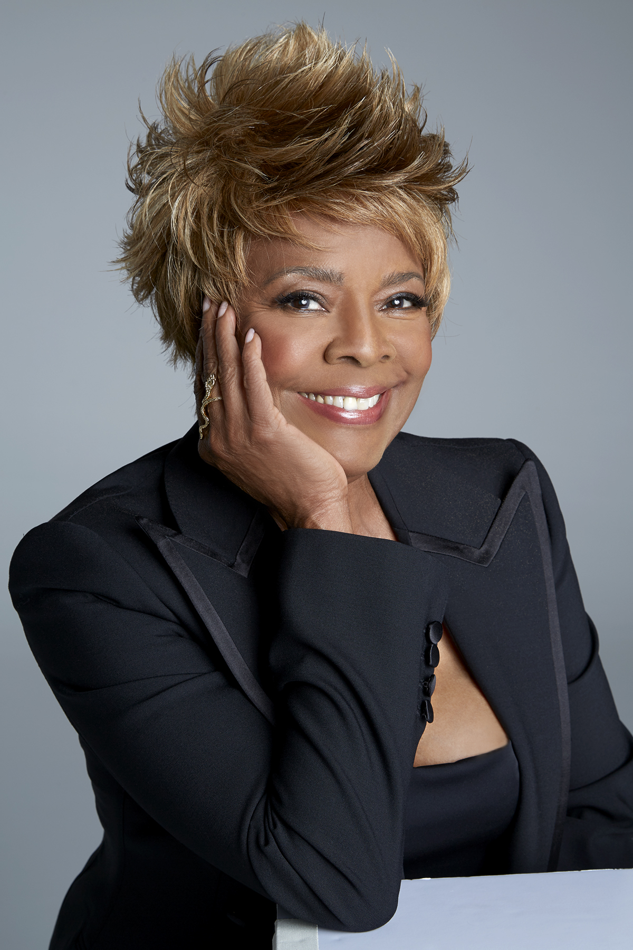
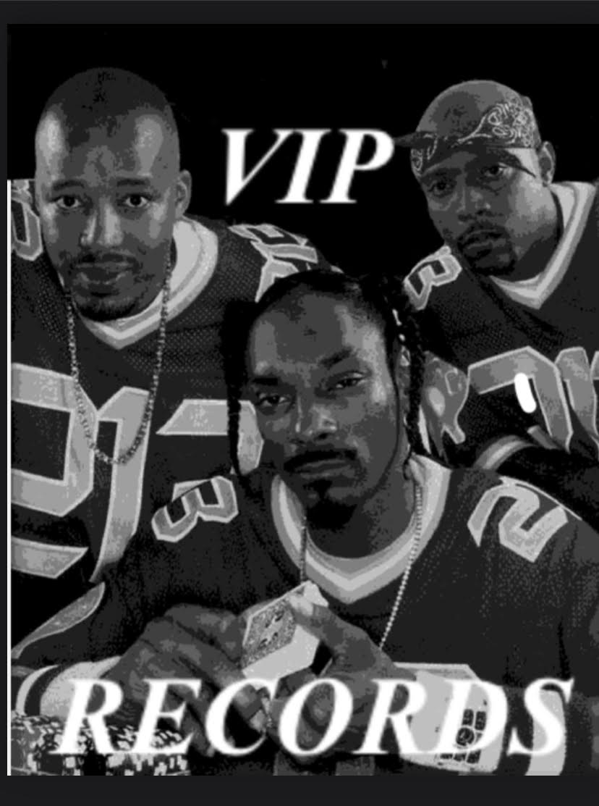
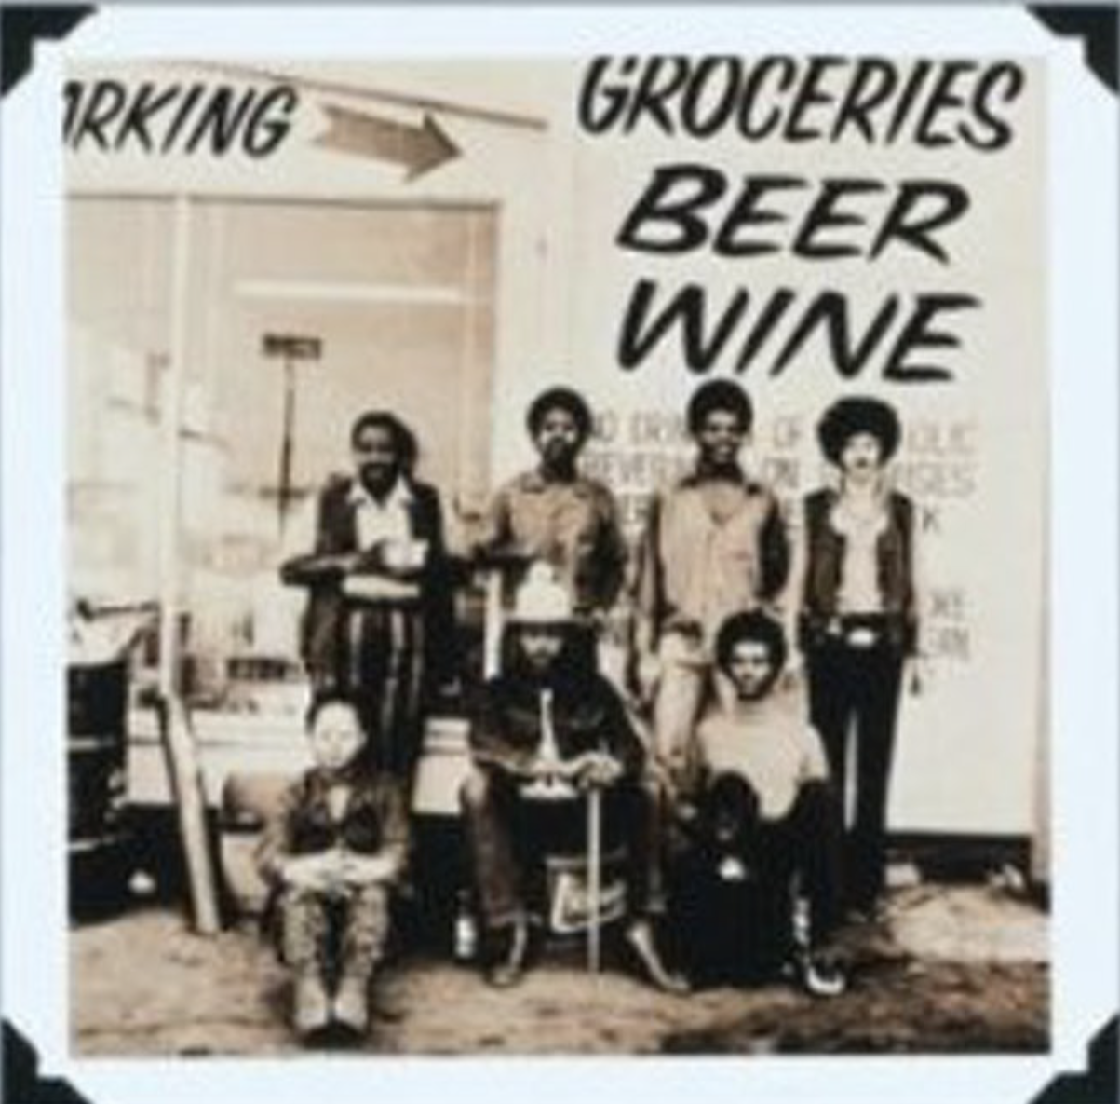
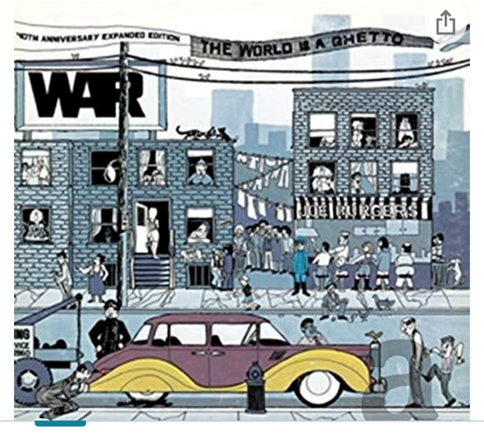
Music Before there was West Coast Rap there was Soul & R &B in the LBC
Thelma Houston
Warren G, Snoop & Nate Dogg
WAR

Slide 14
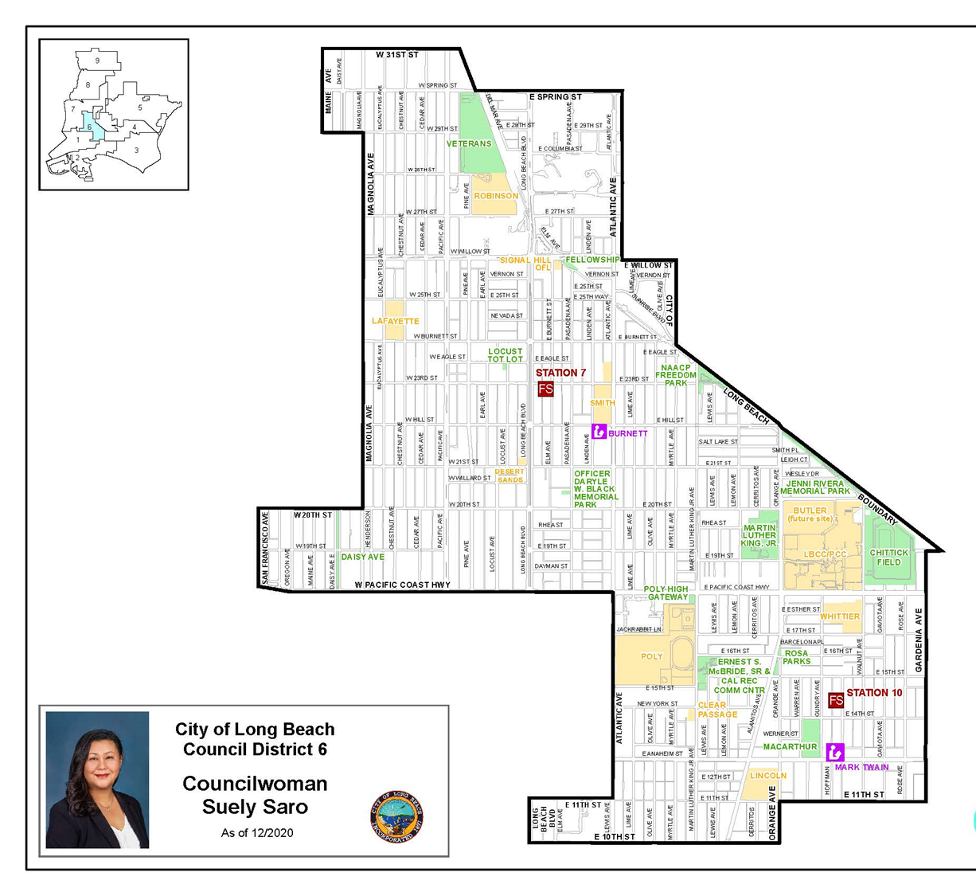
Looking Ahead! Recovery Act Fund Reinvestment

Slide 15
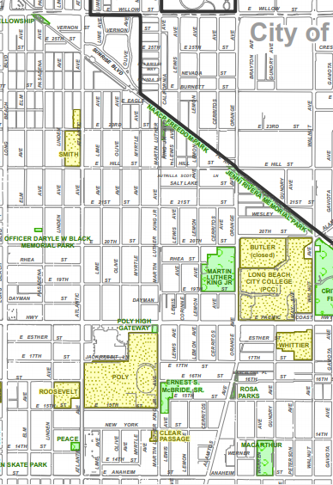
Heritage Park
Historically African American Community
Borders:
10th Street to the South
Willow Street to the North
Long Beach Blvd to the West &
Walnut Avenue to the East
with the corner of MLK & PCH designated as a cornerstone, historic landmark for the African American community.
HERITAGE PARK

Slide 16
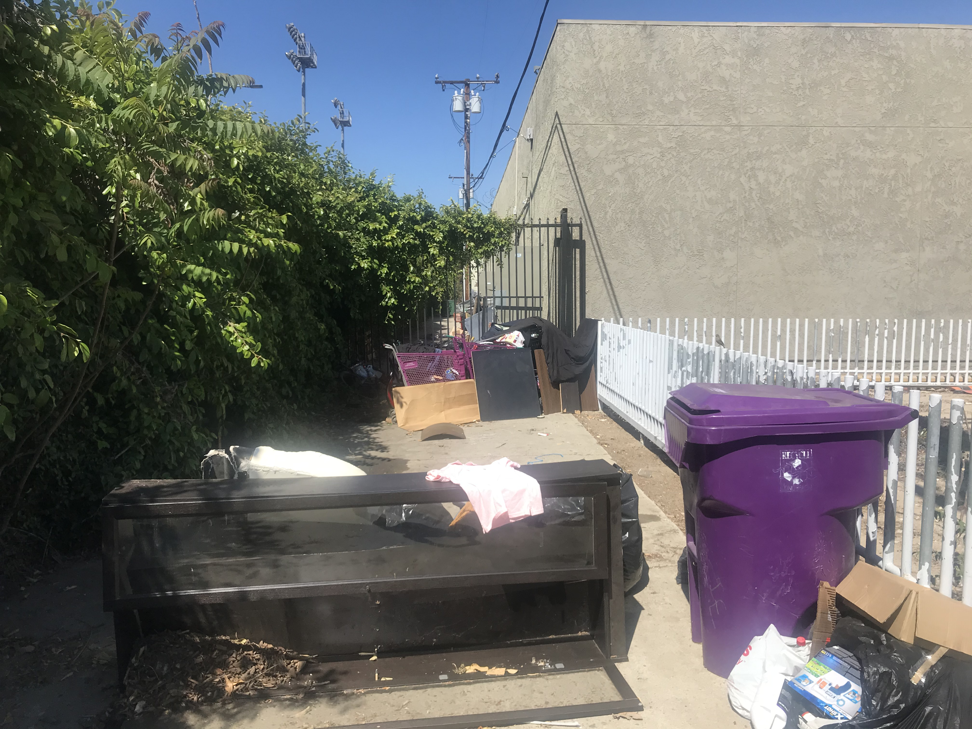
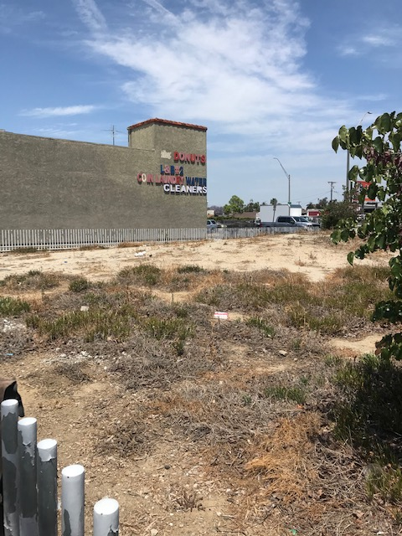
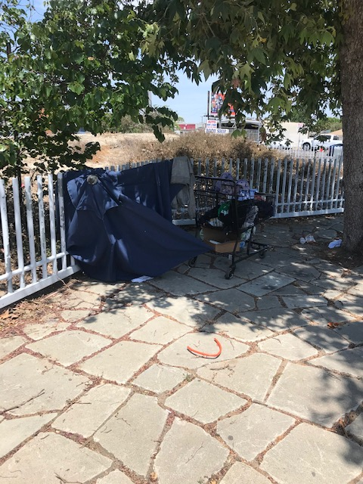
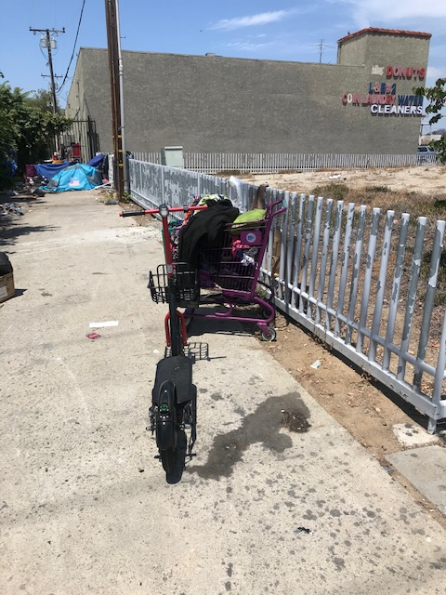
MLK & PCH – HIGHWAY CENTER
Heart of Black community and needs to attended to regularly!

Slide 17
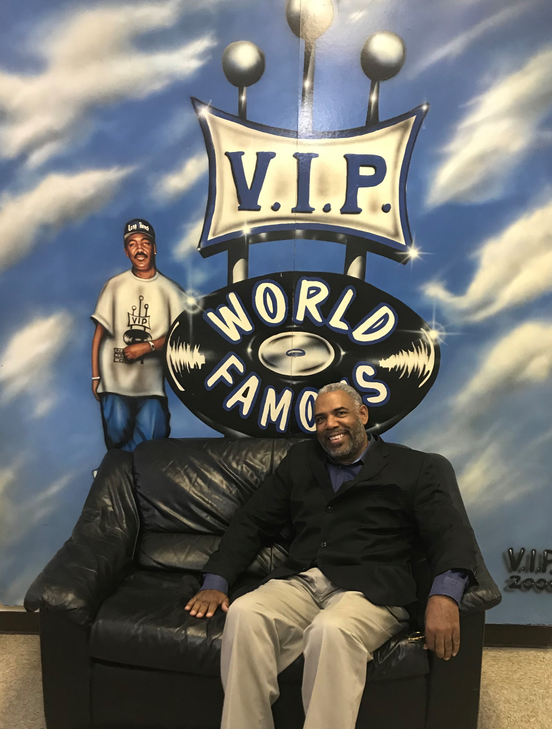
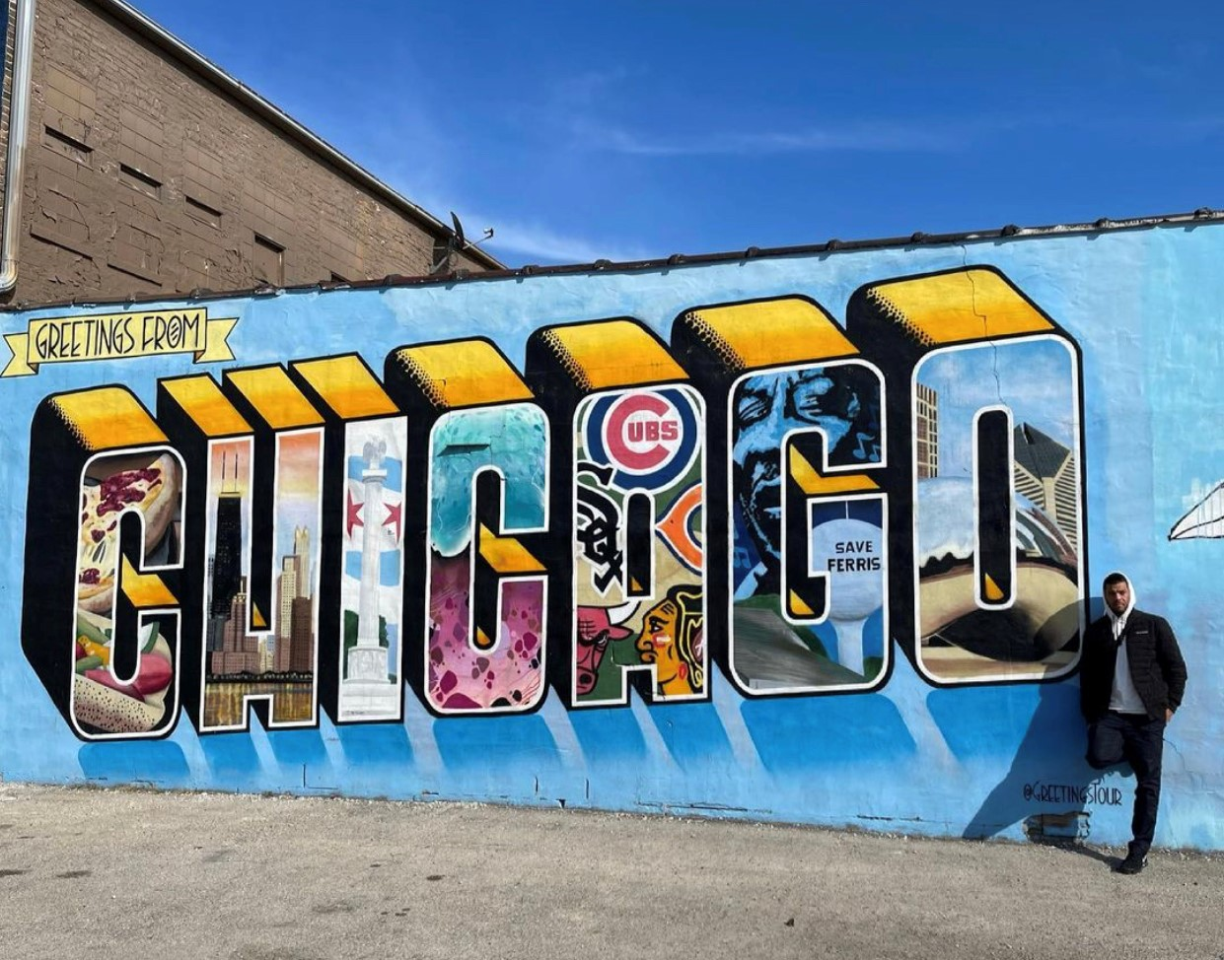
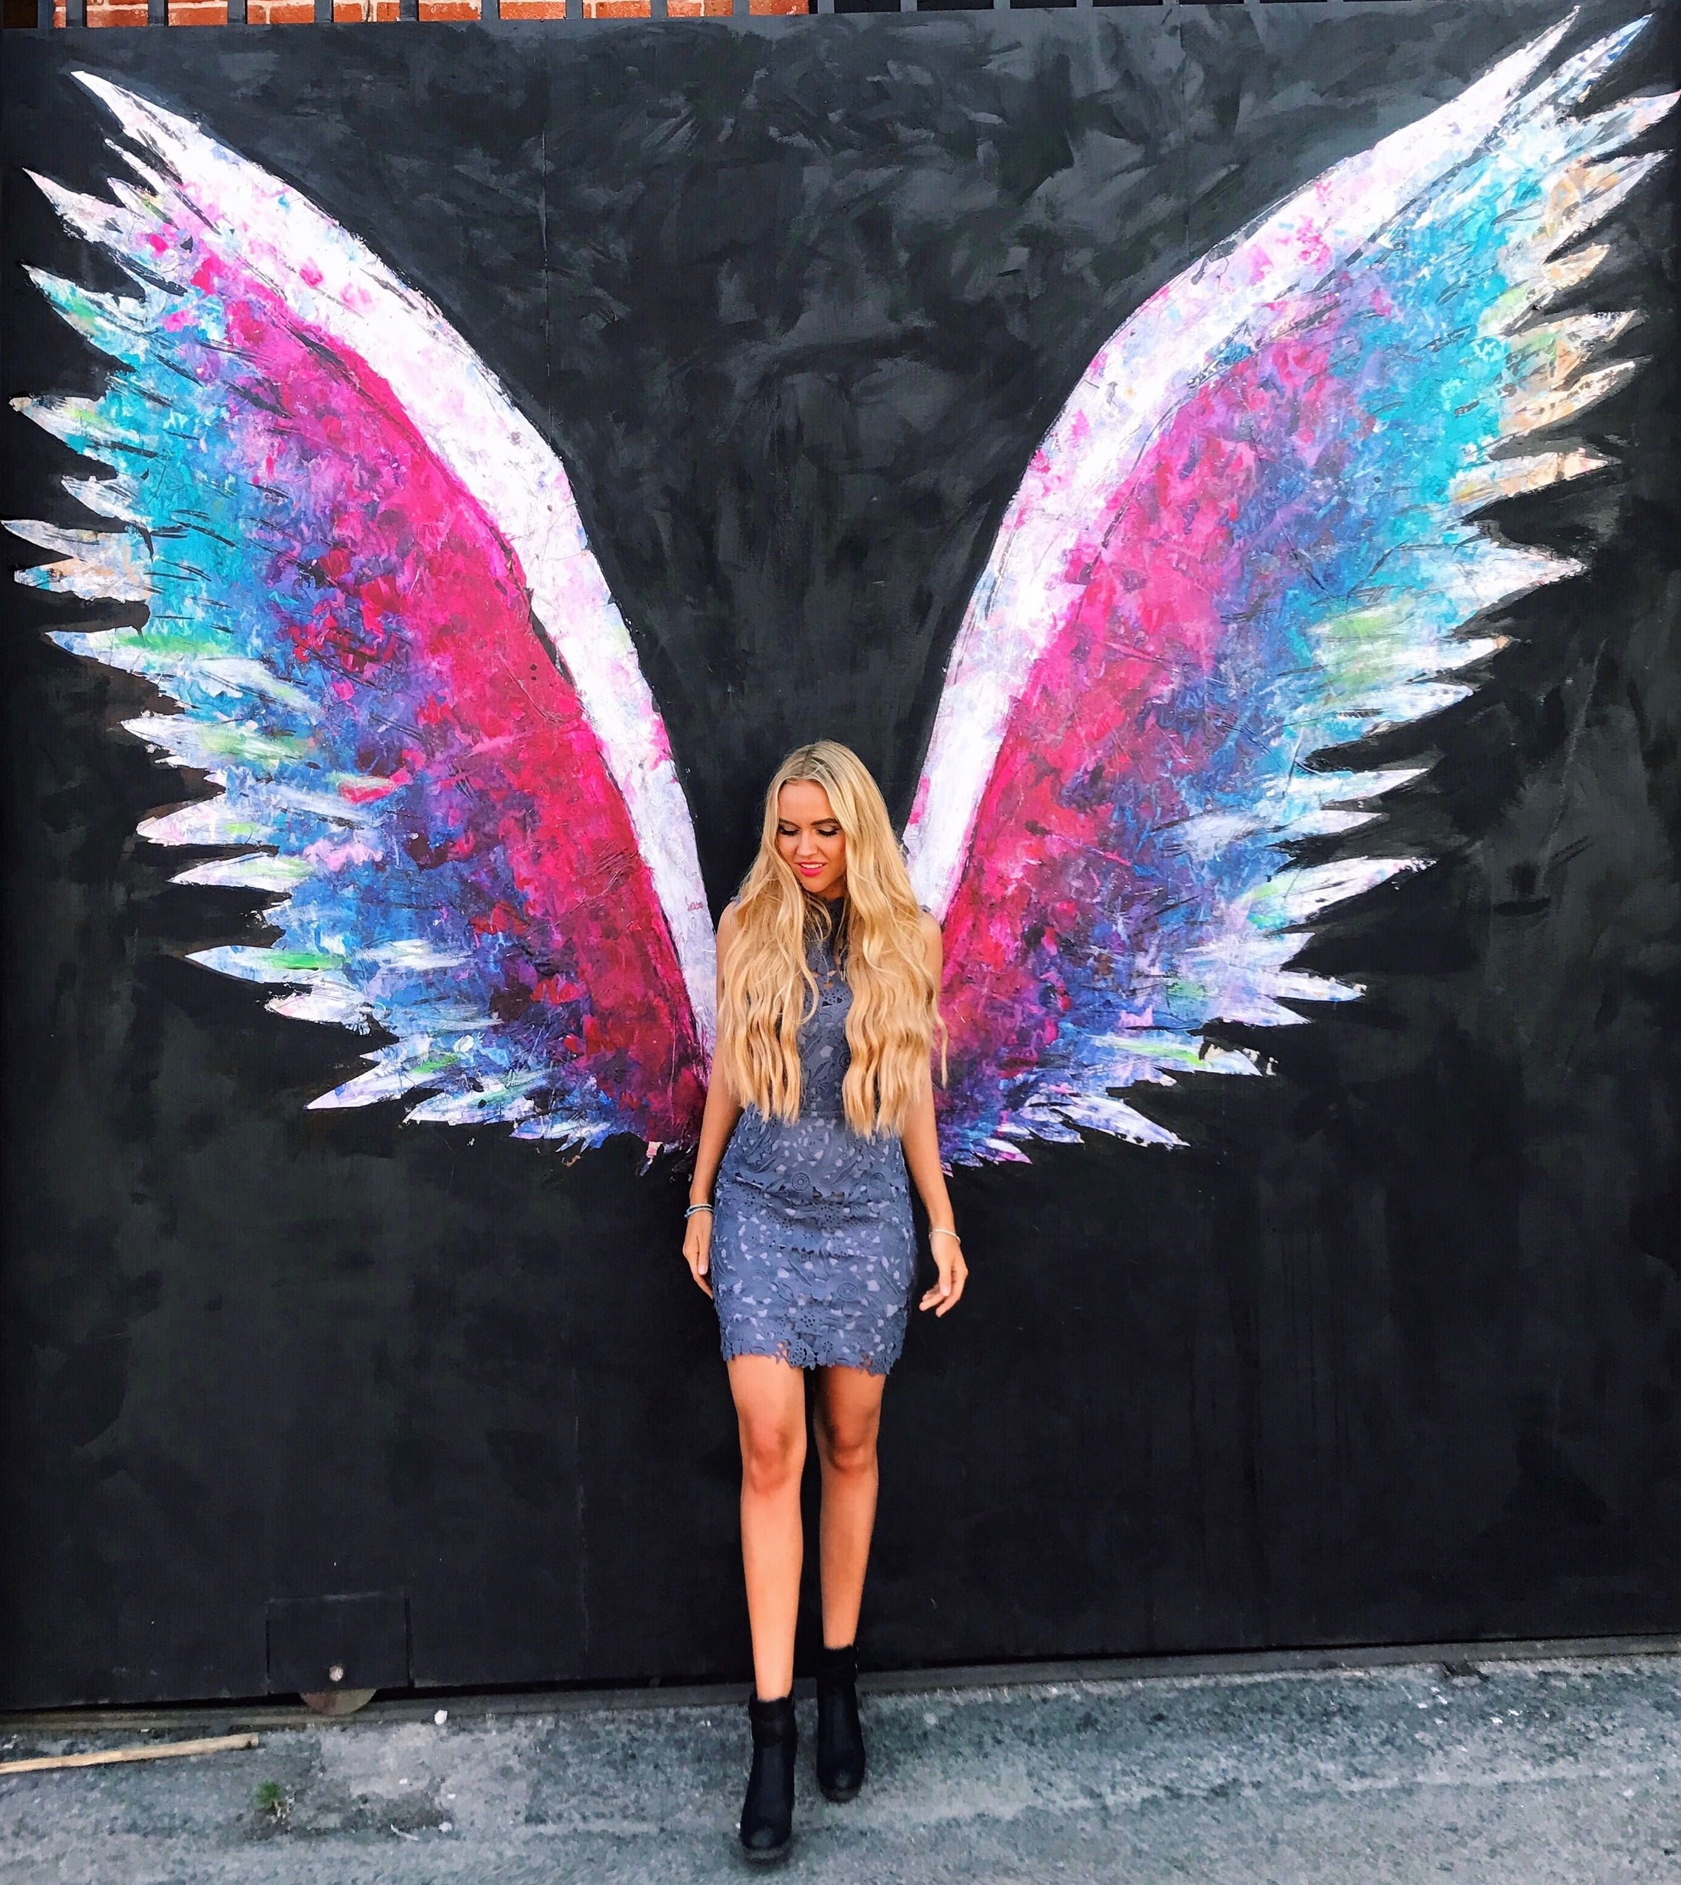
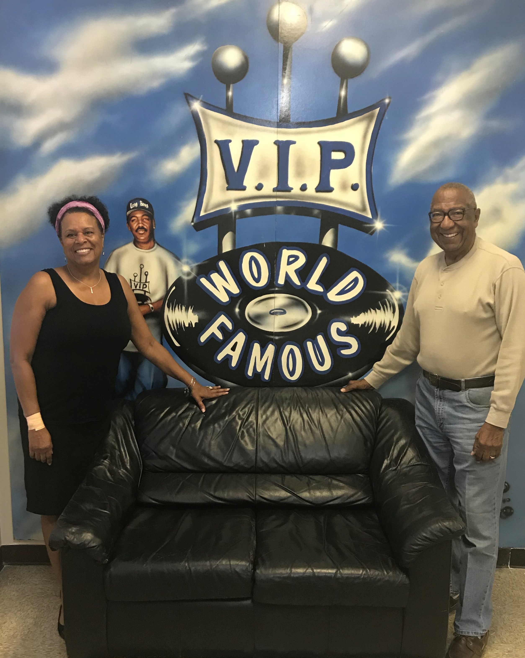
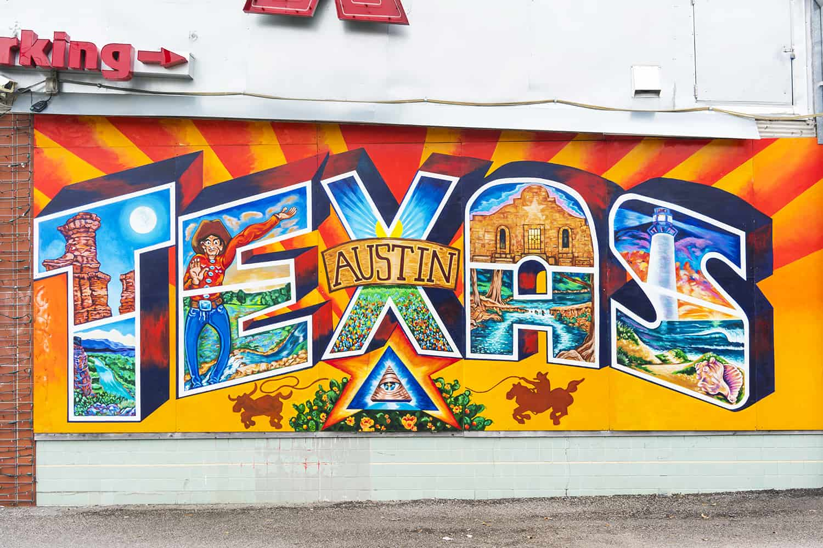
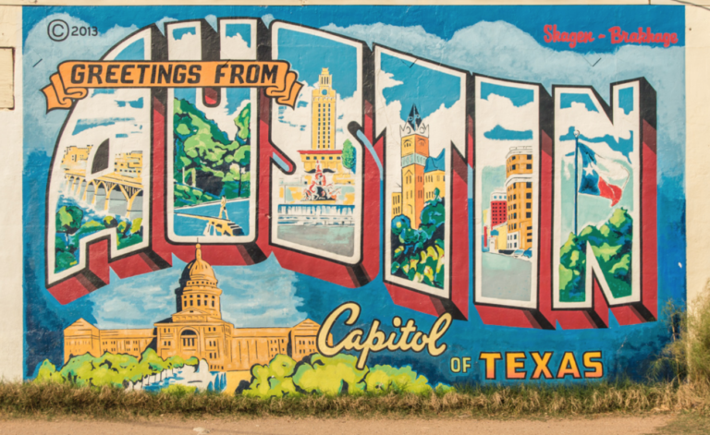
Potential for a Destination Wall Installation MLK & PCH

Slide 18
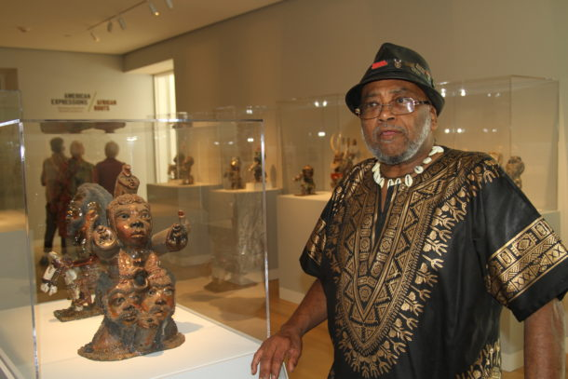
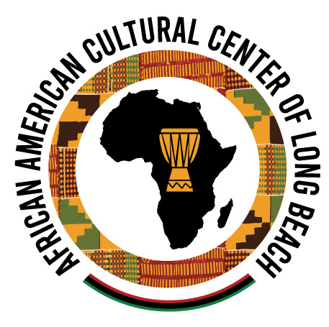
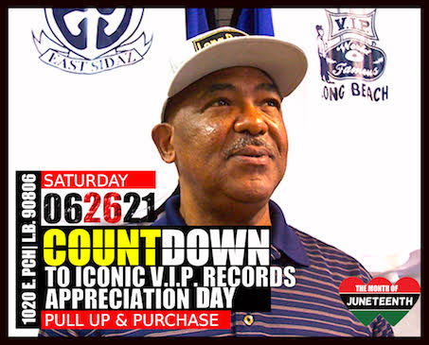
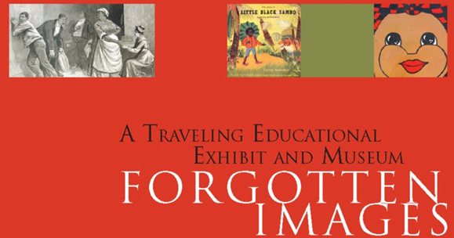
Continued support of the African American art community such as AACCLB, but also the Pan African Art Study & Forgotten Images. The last two have been built without any real assistance.

Slide 19
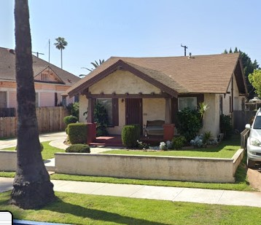
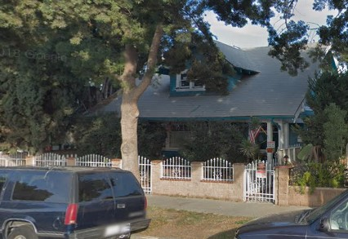
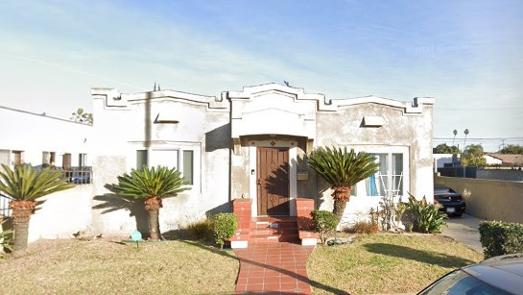
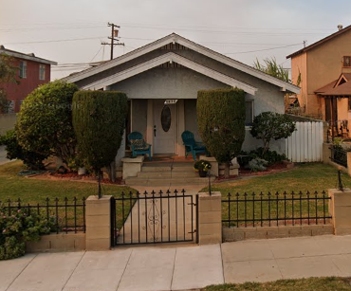
Housing
1st generation Black homeowners
2017 Lewis Ave
1138 Myrtle Ave
2369 Olive Ave
1446 Olive Ave

Slide 20
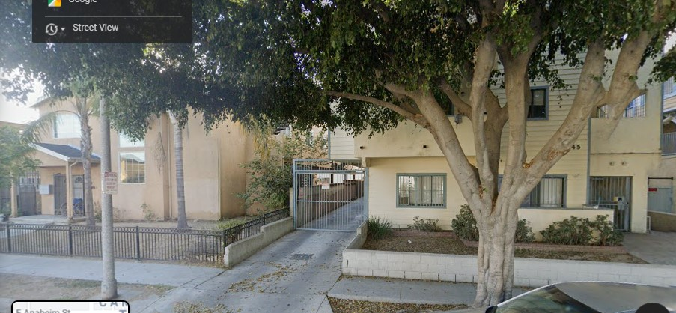
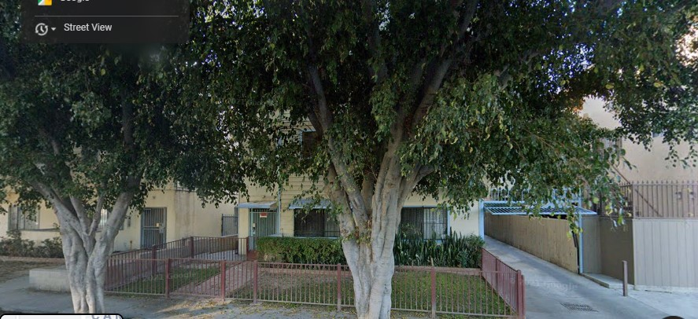
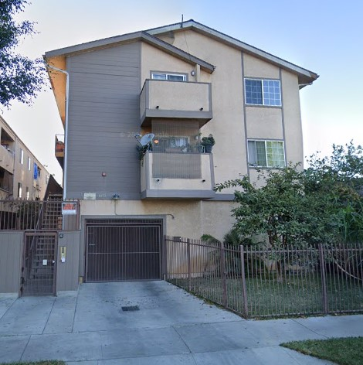
Impact of Crackerboxes
1st generation Black homeowners, 6 built on former single family, density increased 500+% without any increased resources
1052 Myrtle Ave
1042 Myrtle
1060 Myrtle Ave

Slide 21
Home Improvements
Multi-Family Rehabilitation Loan Program:
The Home Improvement Rebate Program (HIRP) reimburses eligible owners of residential properties up to $2,000 to improve the exterior of their properties. Since 1987, property owners have received rebates to pay for improvements involving paint, stucco, doors, driveways, porch, and window repairs. Contact the Neighborhood Services Bureau at (562) 570-6866 for more information.
HOME REHABILITATION LOAN PROGRAM
Low-cost loans are available to repair homes and apartment buildings. These loans can be used to correct building/property deficiencies or other conditions which, if not corrected, will soon become a deficiency.
This program provides low-cost loans, with no maximum loan amount, available to qualified applicants at 0% interest with a 20-year loan term for owners of rental units of five or more units.
What is the Home Improvement Rebate Program?
It is a City program that provides a reimbursement of up to $2,000 to eligible property owners with exterior code violations visible from the street to improve the exterior of their residential properties.
Who is Eligible?
Property owners of both single-family and multi-family owner occupied or rental property with exterior code violations visible from the street are eligible. Income limits apply for property occupants.
**There is an opportunity to create a home improvement program for this area that provides job creation and OJT for LBCC students.**

Slide 22
Economic Development Empowerment Zone Central Area Business Association Midtown Business Improvement District
There is a need, and there is potential, for business development within the Central Area!

Slide 23
Specific Ask
1. Designate Heritage Park
2. Enter into lease/development agreement with Elite Skills to manage and develop property at 998 E. PCH and the corner Atlantic Ave and PCH
3. Initiate a Banner Program (AA Churches, landmarks) & Historic Markers
4. Revamp MLK from Anaheim to 20th Street, PCH LB Blvd to Alamitos

Slide 24
